Slide 1

E&M Auto Routing Design with AI - ARAI
G&K Consultancy Ltd. AND SZU

Slide 2
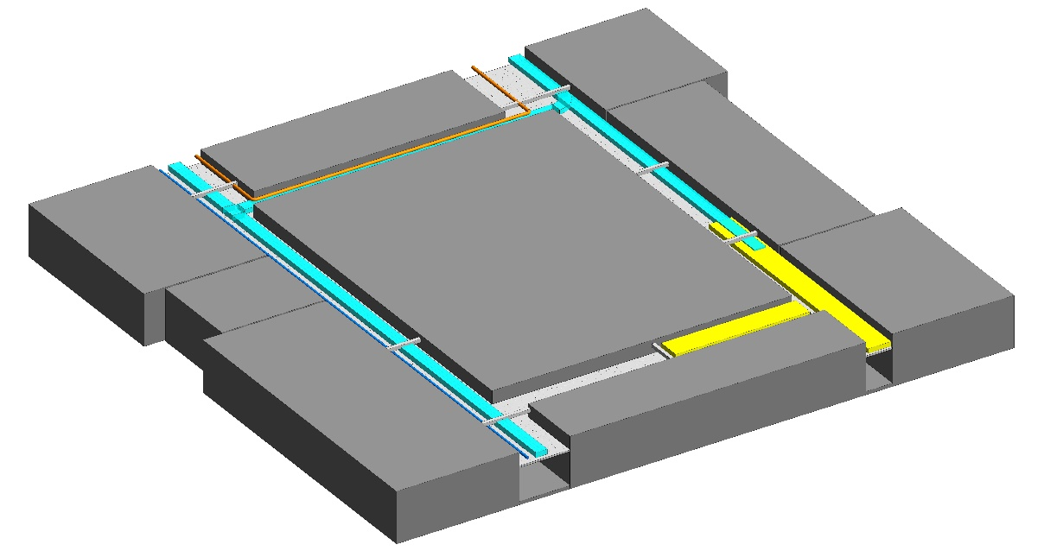
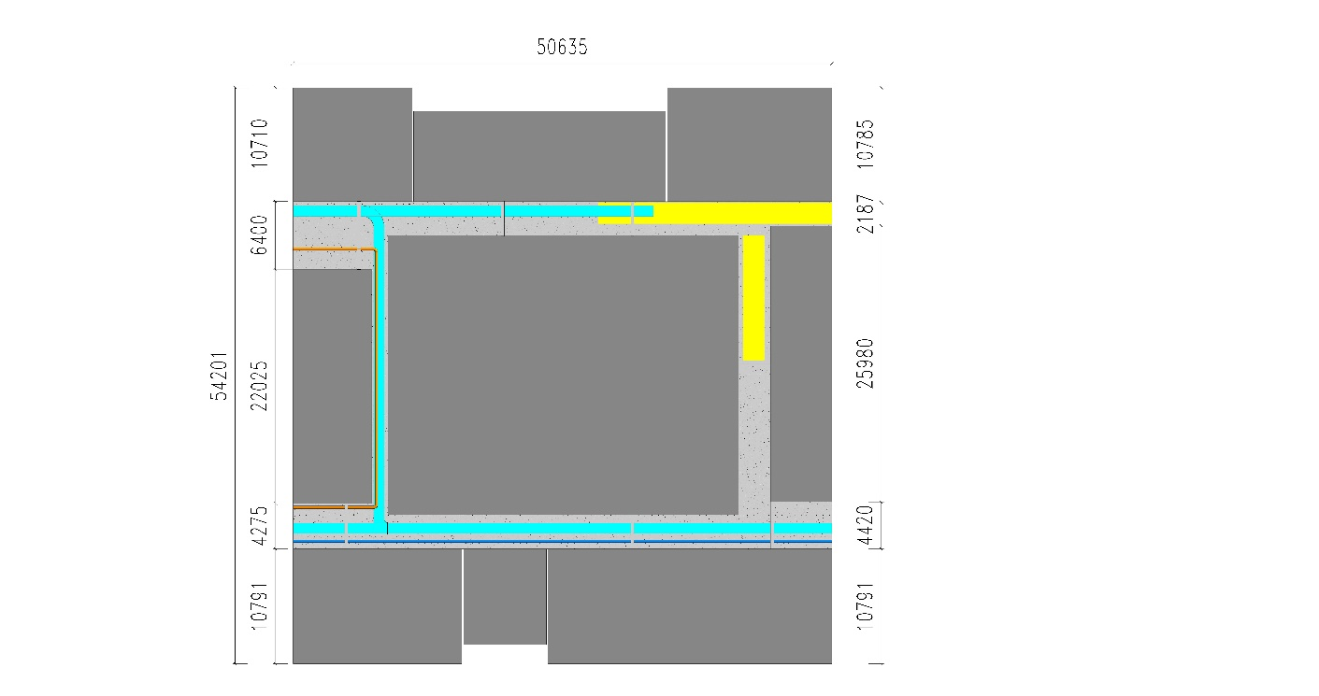
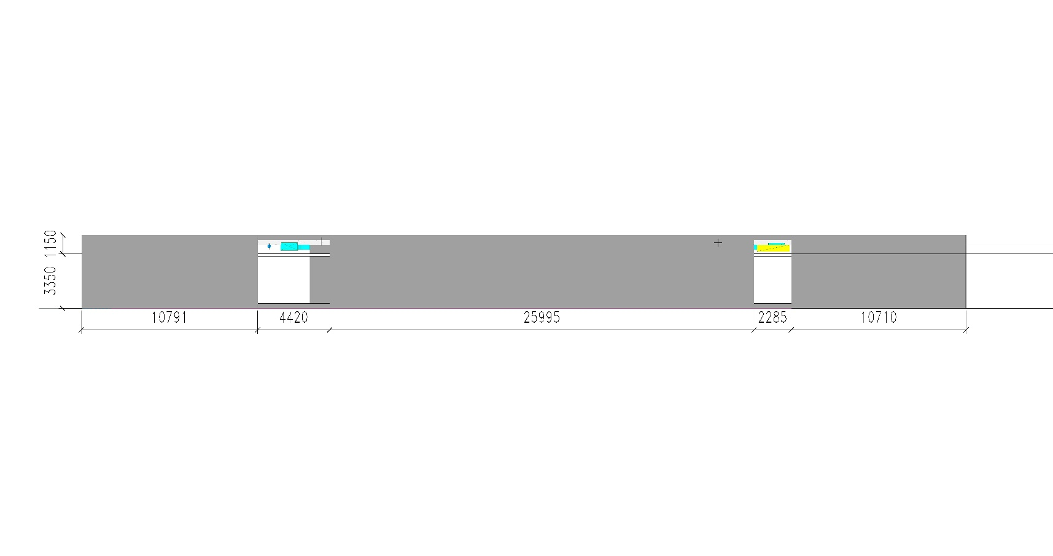
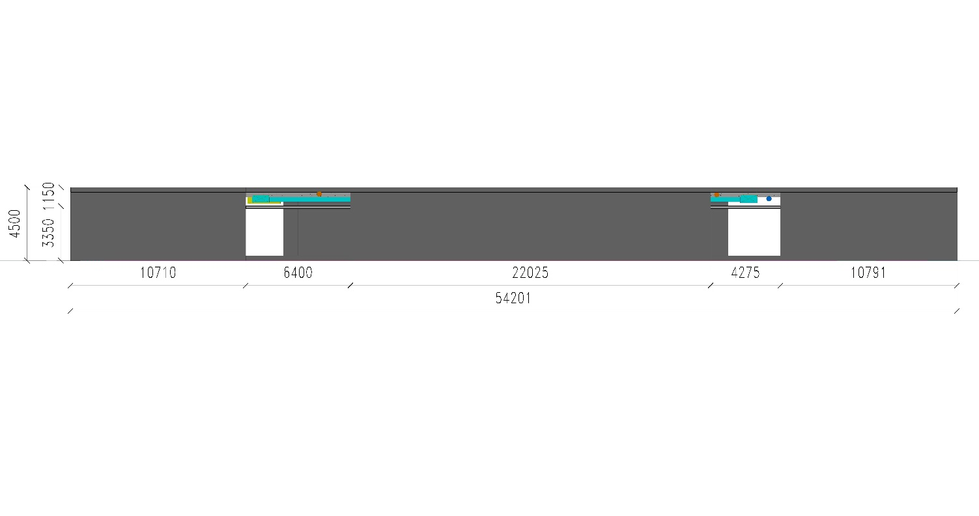
Algorithm output: case example
Revit input data
1000mmx400mm MVAC
2000mmx400mm MVAC
Φ250mm GraFlow
Φ250mm GraFlow
East Section
Plan
Problem:
different types of pipes occupy same space
Some law might be violated (e.g. 30m’ law)
Might not be enough space (height)
West Section

Slide 3
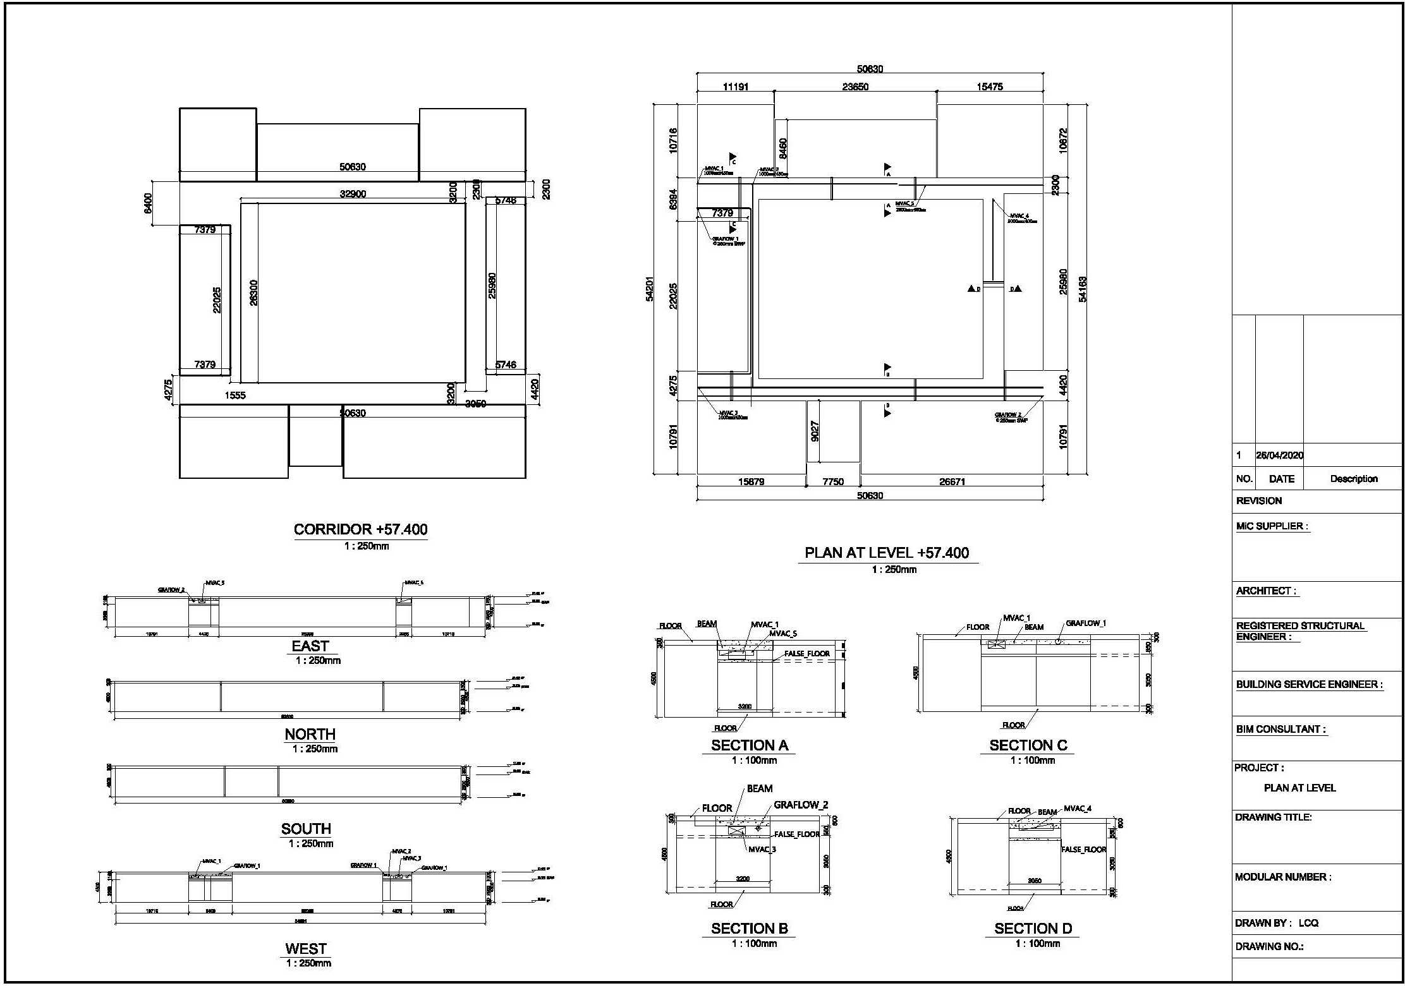
CAD input data

Slide 4
Algorithm output: case example
Input explanation:
We transfer the pipes into formatted data to input to the algorithm
This step can be carried out by software once it is developed
All pipes in the formatted data will not have height information in input
The algorithm will do (most important parts):
Locate all pipes, including height information, where to turn to avoid collision / to be ‘行气’
Shape changing if allowed and necessary
Through the beam if allowed and necessary
Warning if necessary

Slide 5
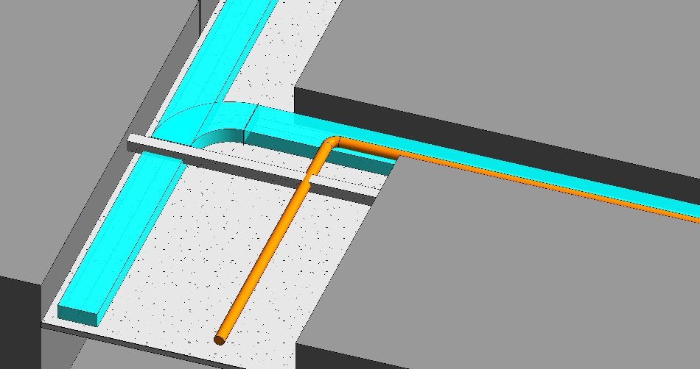
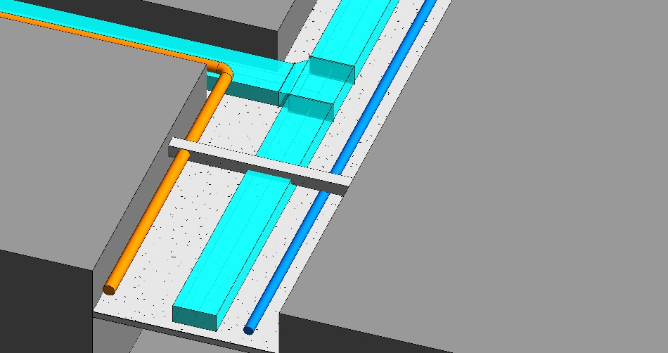
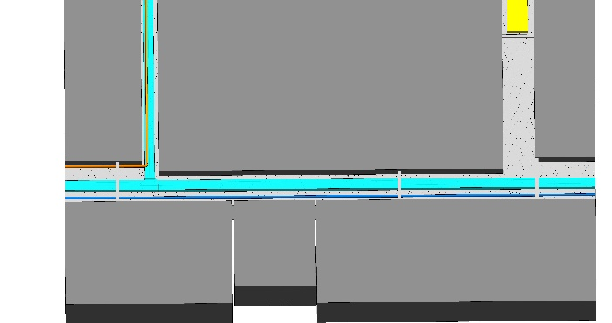
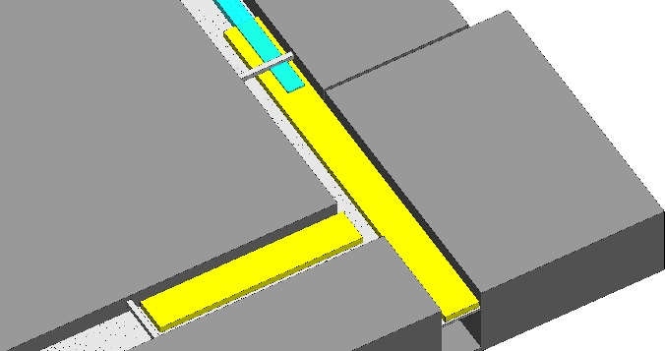
Algorithm output: case example
In the Revit input figure, all pipes are random draw (height and place in the corridor) above suspended ceiling, therefore there will be a lot of collision, or might look stupid

Slide 6
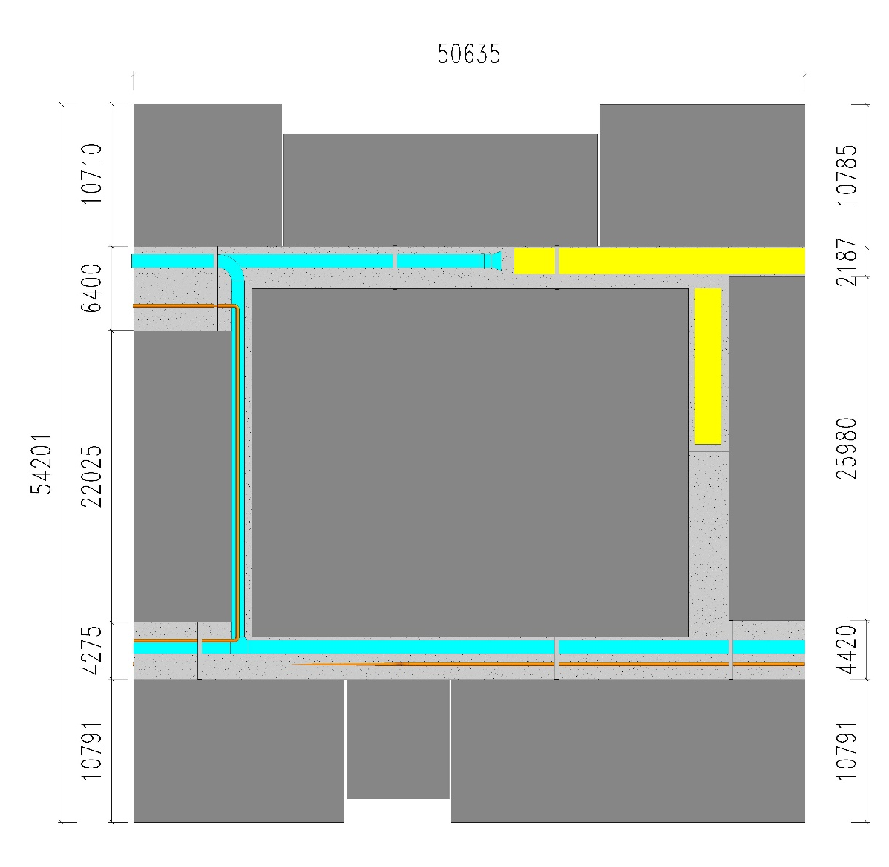
Algorithm output: case example
Output explanation
The pipe routing result can be read by an engineer to get Revit
This step can be carried out by software once it is developed

Slide 7
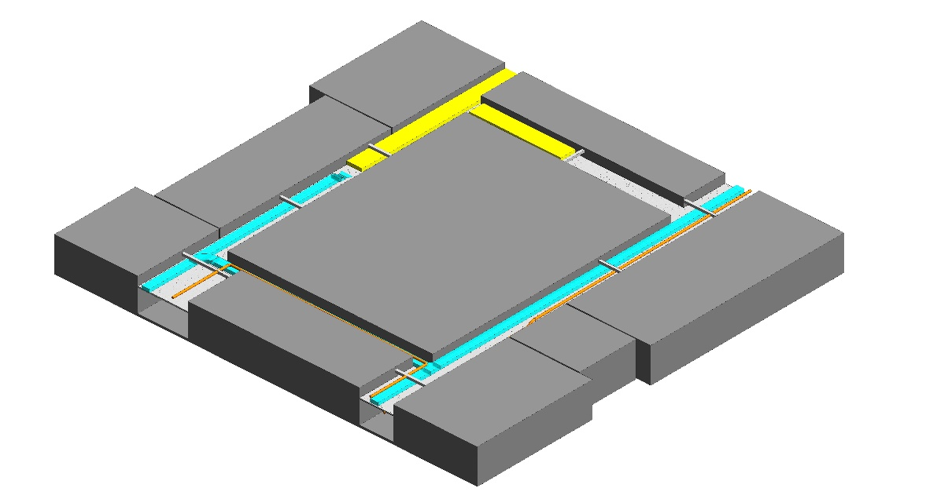

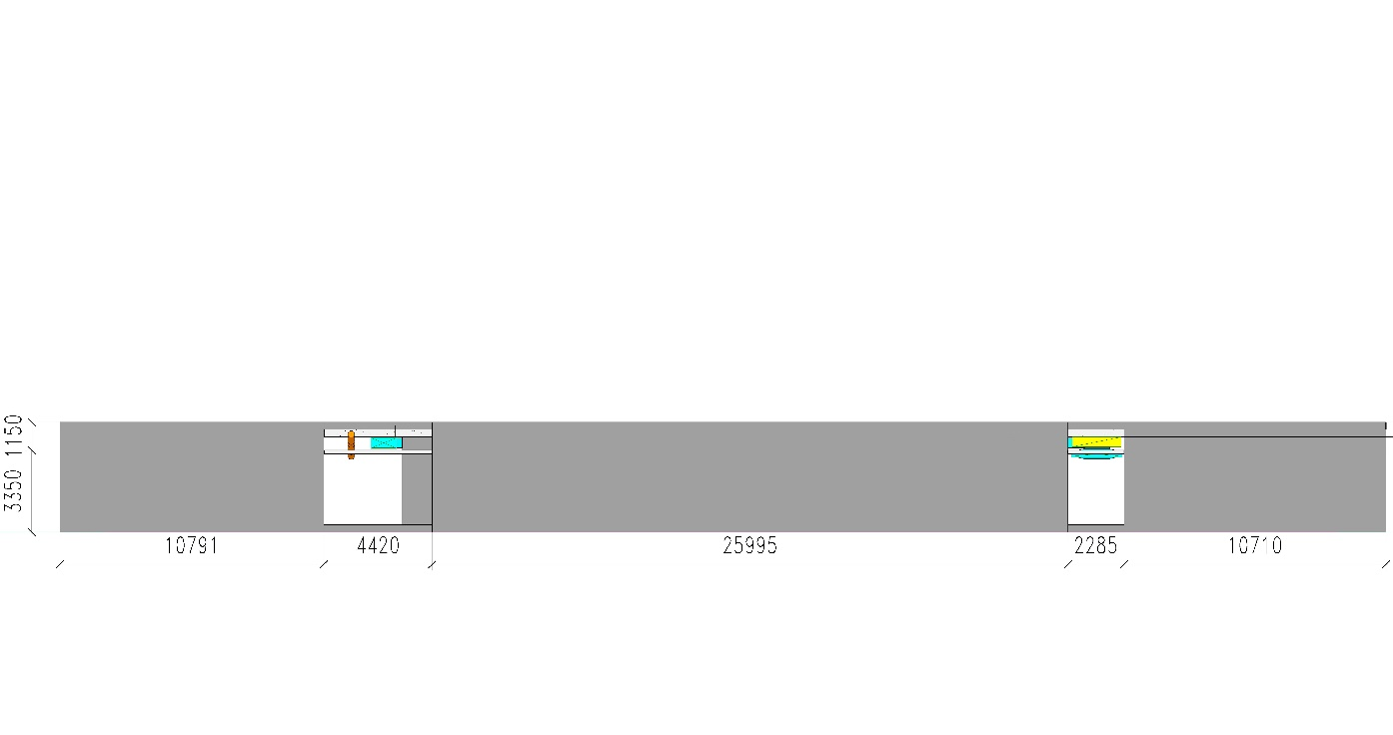
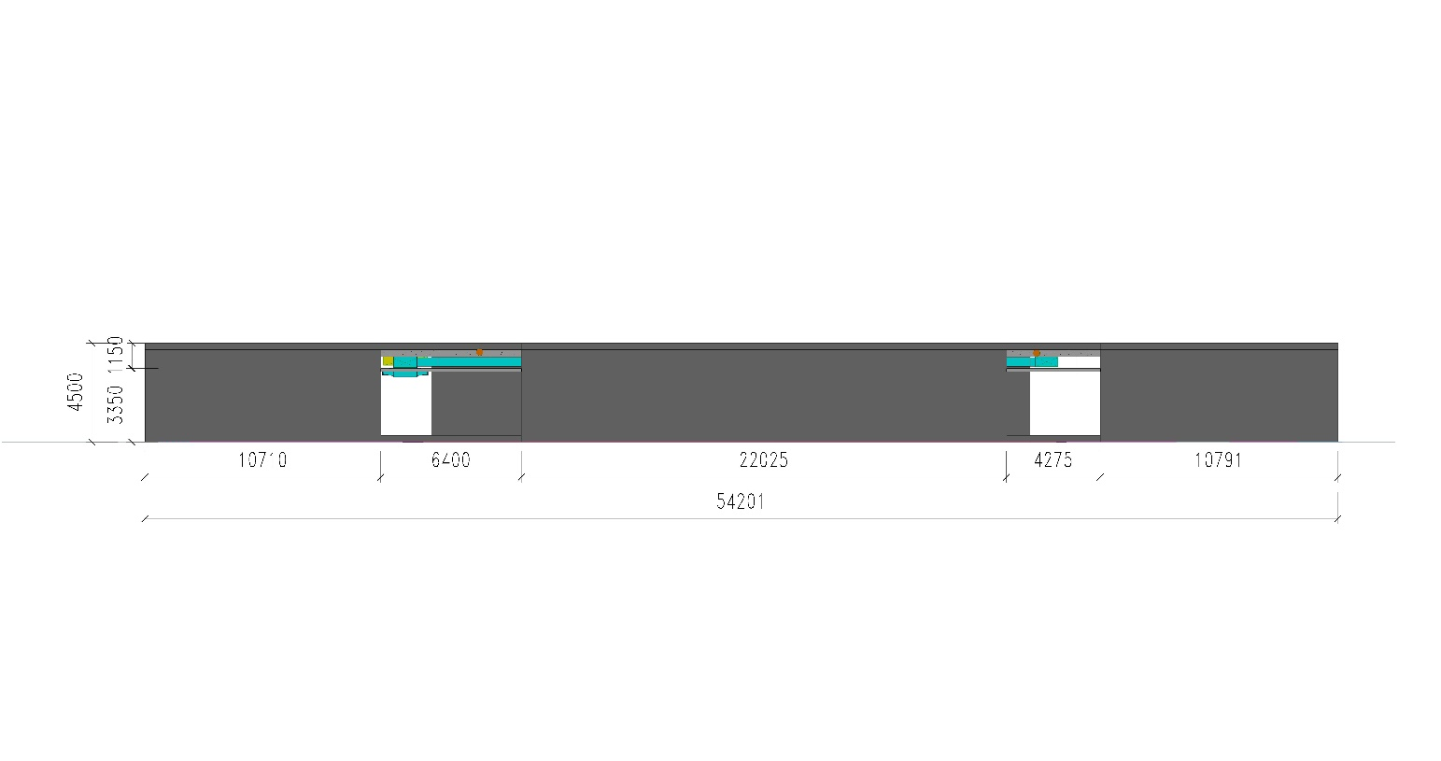
Algorithm output: case example
Program output
1000mmx400mm MVAC
2000mmx400mm MVAC
Φ250mm GraFlow
East Section
Plan
West Section
We will go back to explain this case latter, now we move on to see how it works

Slide 8
Algorithm output: functional examples
Some functional examples:
Spacing between pipes (A,B,C)
Crossing over and size changing (A,B,C)
30m’s law for gravity drainage pipes
Through beams (A,B)
Automatic aligning

Slide 9
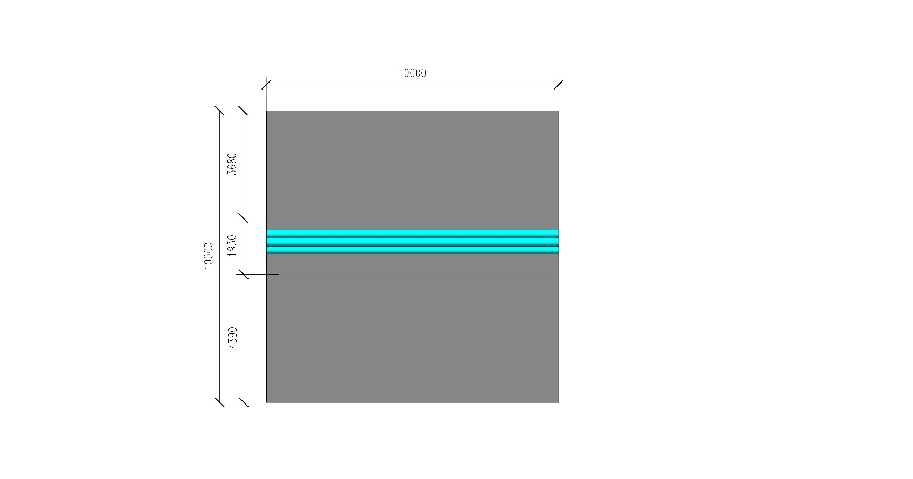
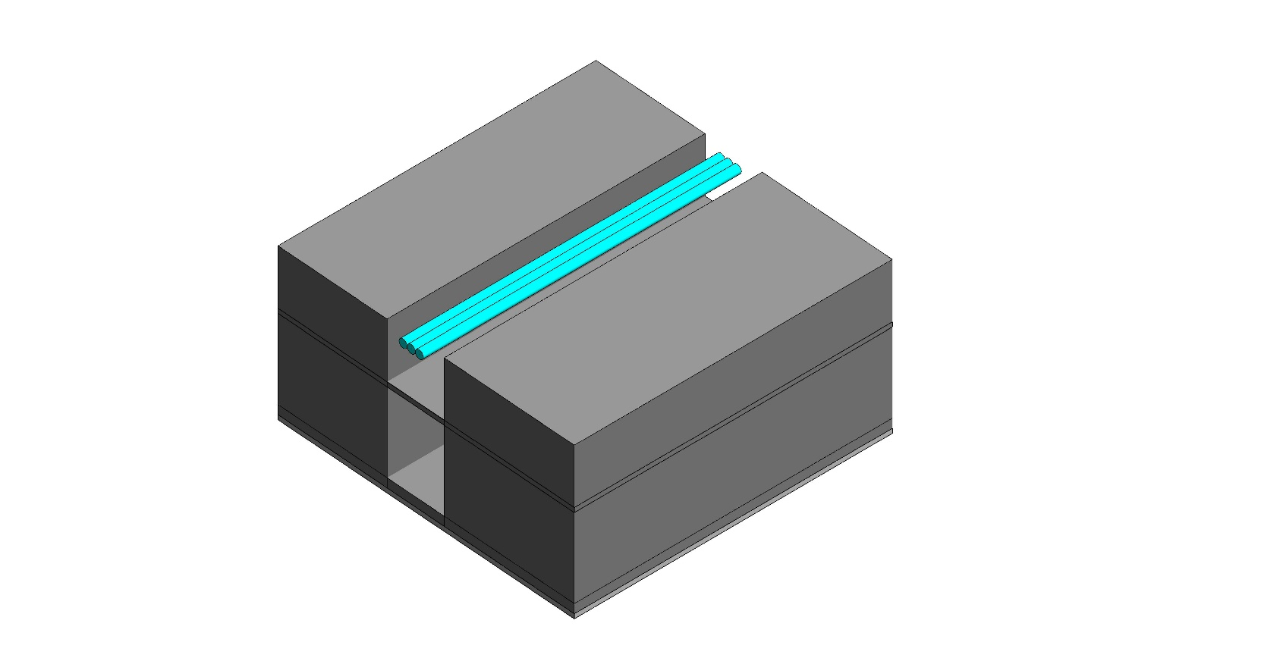
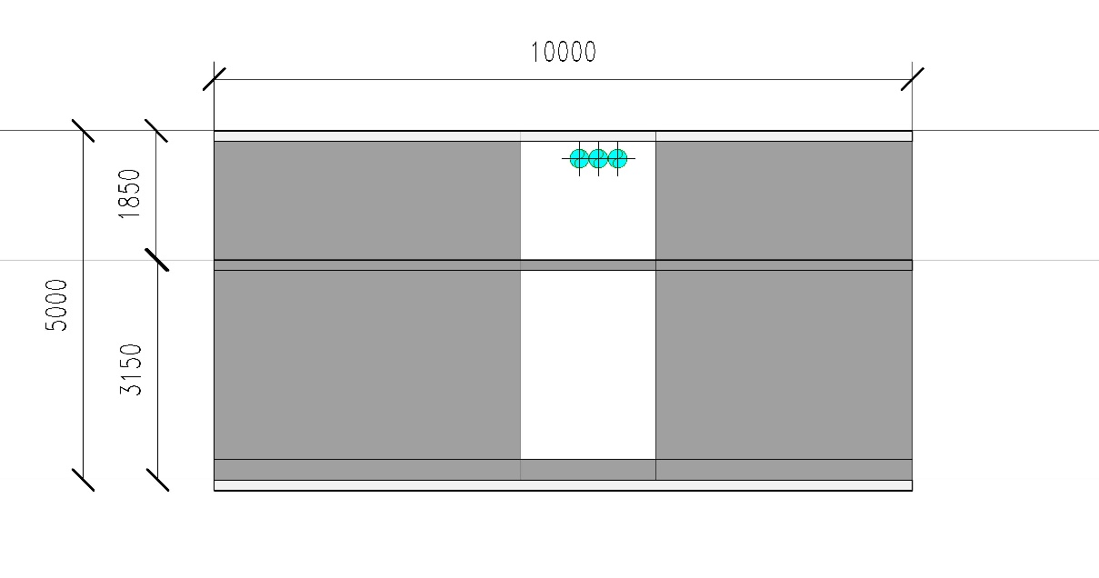
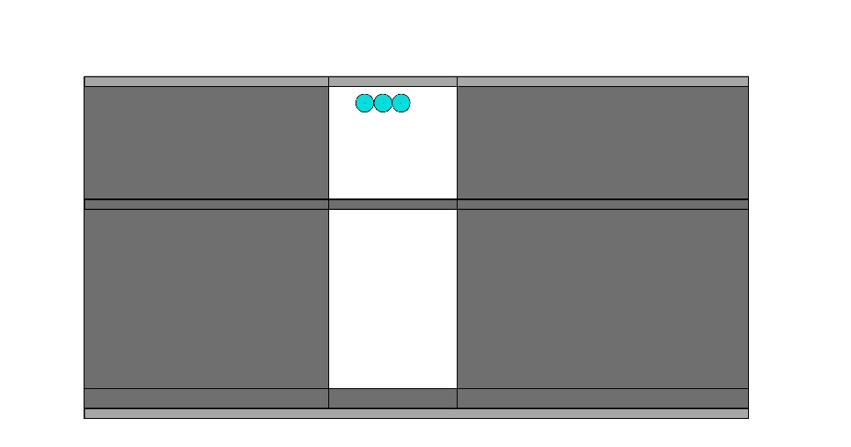
Functional examples: Spacing A
Revit input data
East Section
Φ250mm GraFlow
West Section
Plan
Problem: no space between pipes

Slide 10
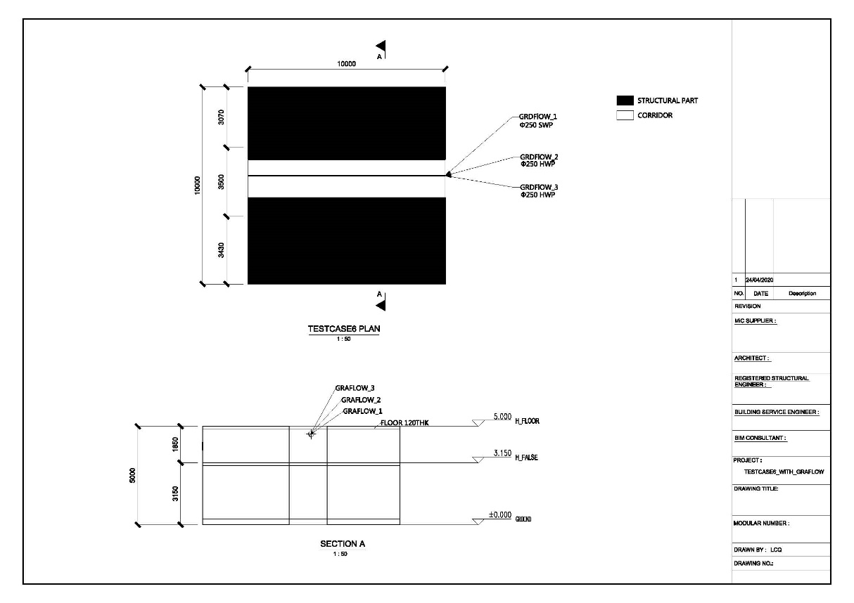
Functional examples: Spacing A
CAD input data
Problem: no space between pipes, especially when drawing under CAD format

Slide 11
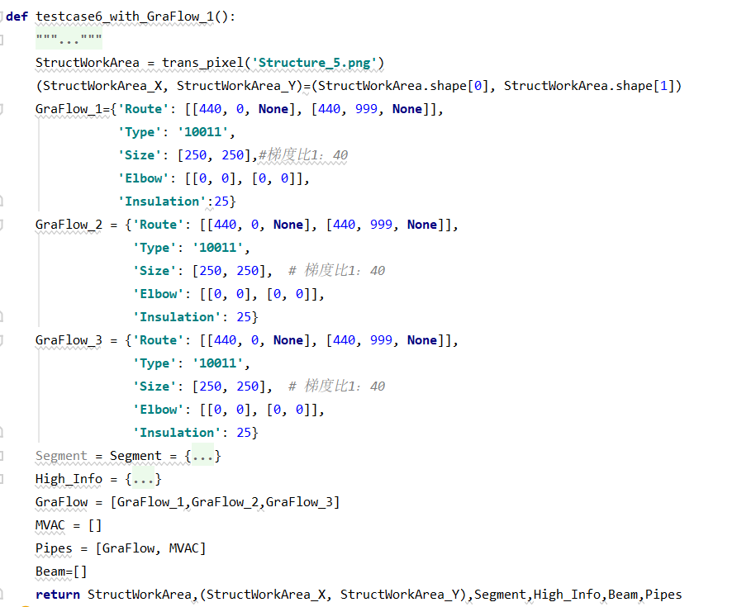
Functional examples: Spacing A
Formatted input
Begin and End: height information is ‘none’ because that is what we need to find out; 3 pipes in the same space and that is what to be tackled
3 pipes in the same space in the input, to be routed to the corrected place by the algorithm
All the types of pipes, including the shape, type, insulation, installation spaces, etc.
For more details: see ‘HH FSE rule based engg 20191127 (amended by RW2)-0.xls’, Z8—Z14, M2—M11, PD10—PD12, etc.

Slide 12
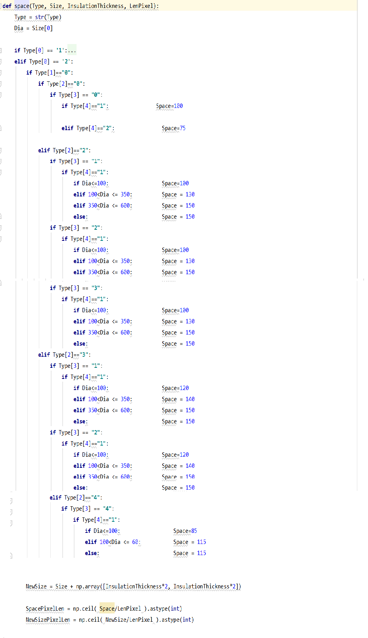
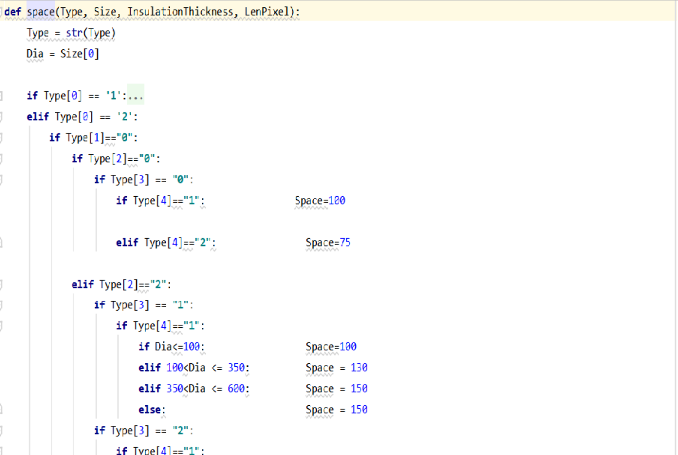
All the types of the pipe, included the shape, type, insulation, installation spaces, etc.
Formatted input
Here is some part of the modeling and program, to show how to add the installation space:
For different types of pipes, different space is allocated

Slide 13
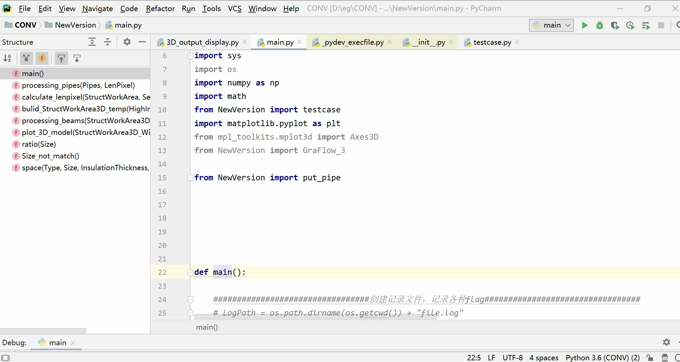
Functional examples: Spacing A
Routing procedure
This short video shows the procedure of routing

Slide 14
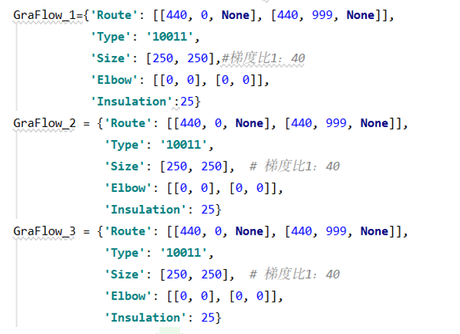
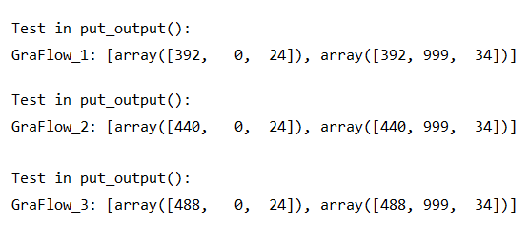
Functional examples: Spacing A
Input: pipes not routed
Program output: pipes in correct space
Begin height: as high as possible
End height: with appropriate slope
Different pipes occupy different space

Slide 15
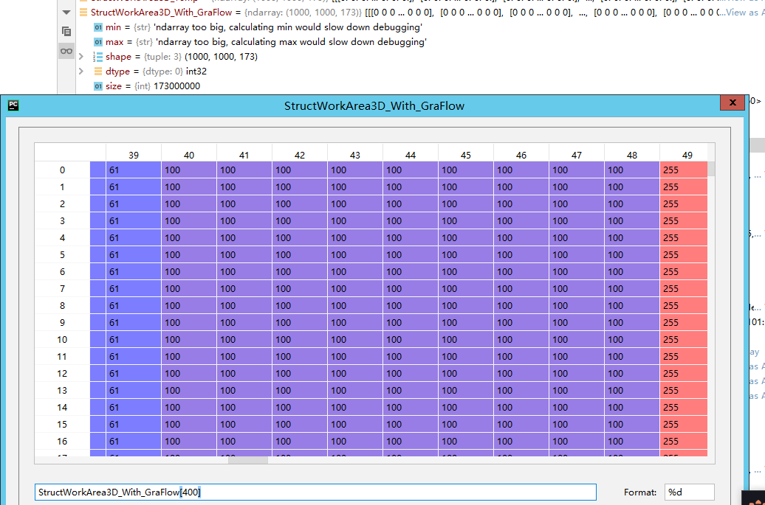
Functional examples: Spacing A
Program output
Visualization step (without Revit): we draw all the pipes in an array, for the figuring

Slide 16
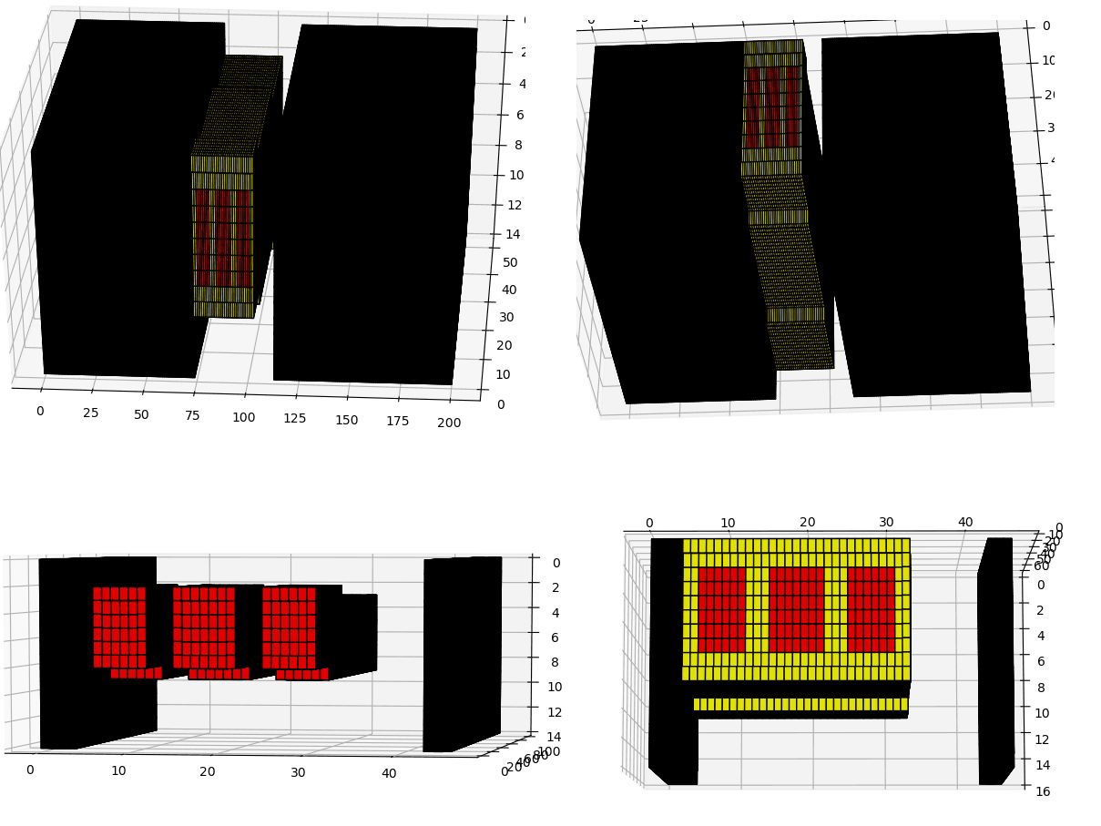
Functional examples: Spacing A
Program output
Color in yellow refers to the space
Color in red refers to the pipes with insulation layer
Note: we draw a cube instead of the circle because it is hard to draw a circle in such point map, however, the pipes is marked to be a circular tube therefore it can be correctly read by Revit.

Slide 17
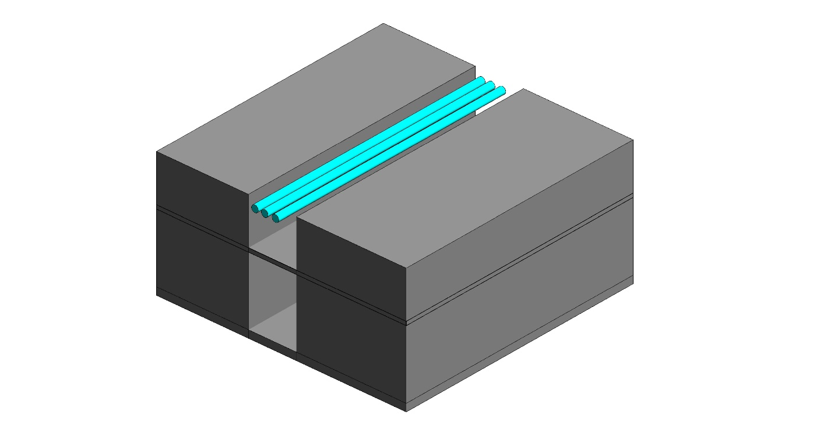
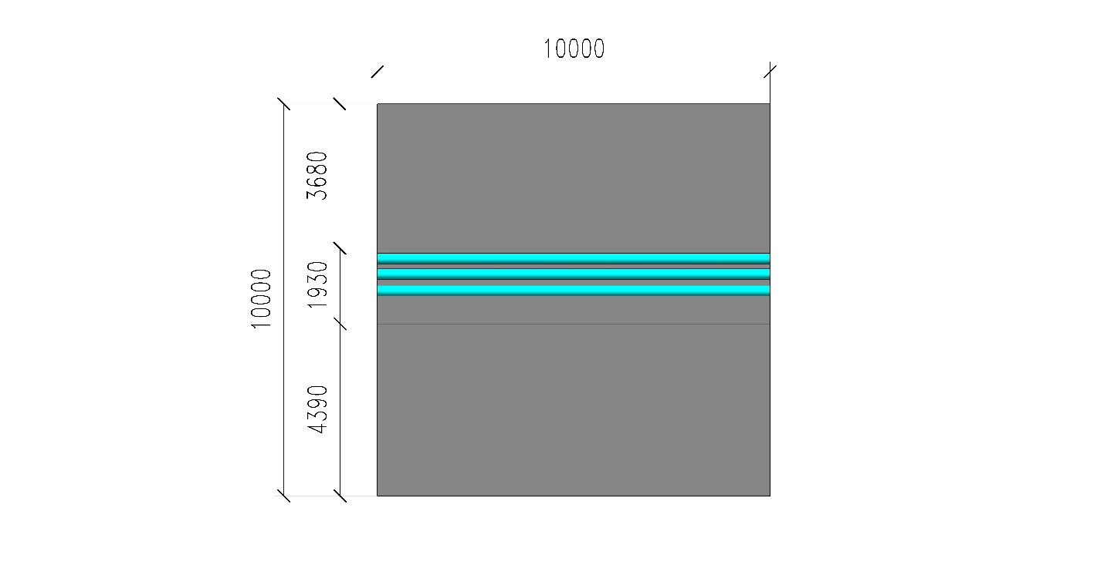
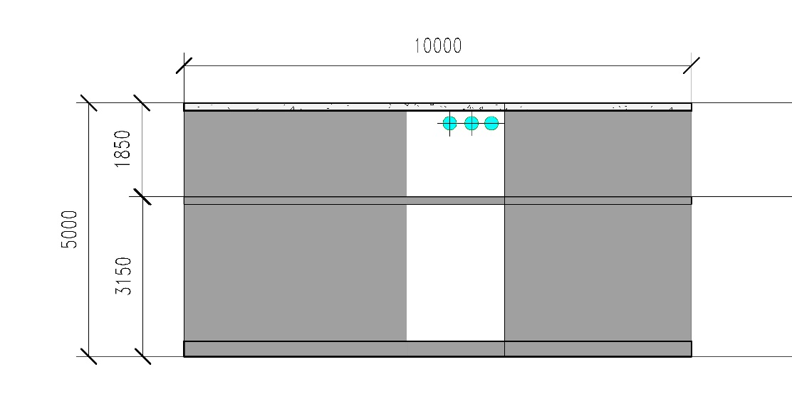
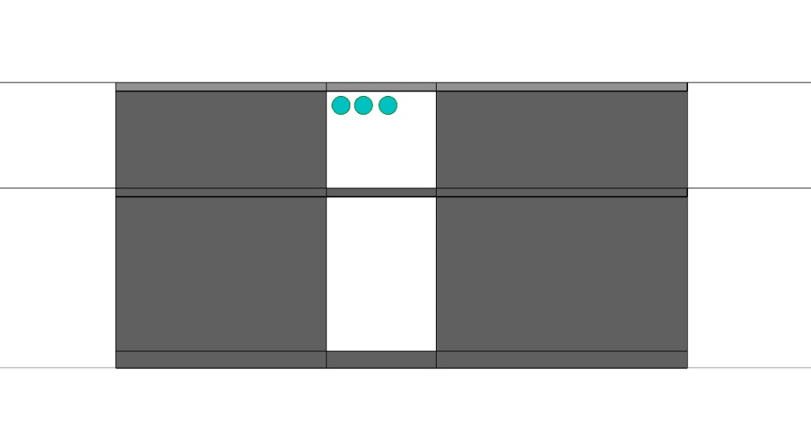
Functional examples: Spacing A
Program output
East Section
Φ250mm GraFlow
West Section
Plan

Slide 18
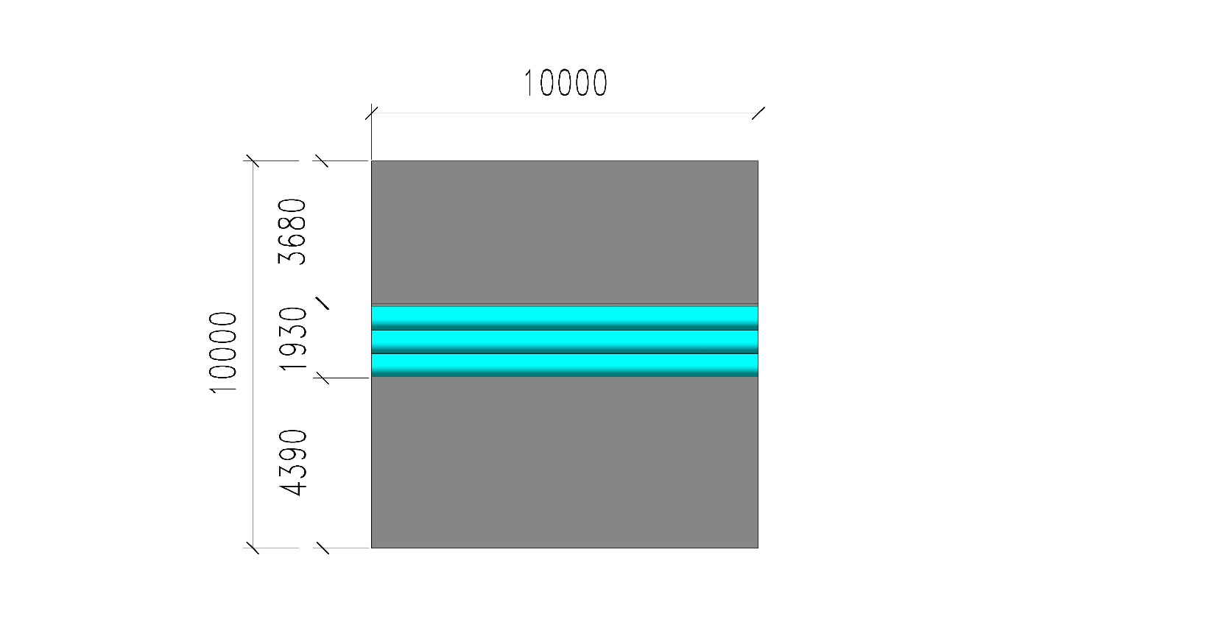
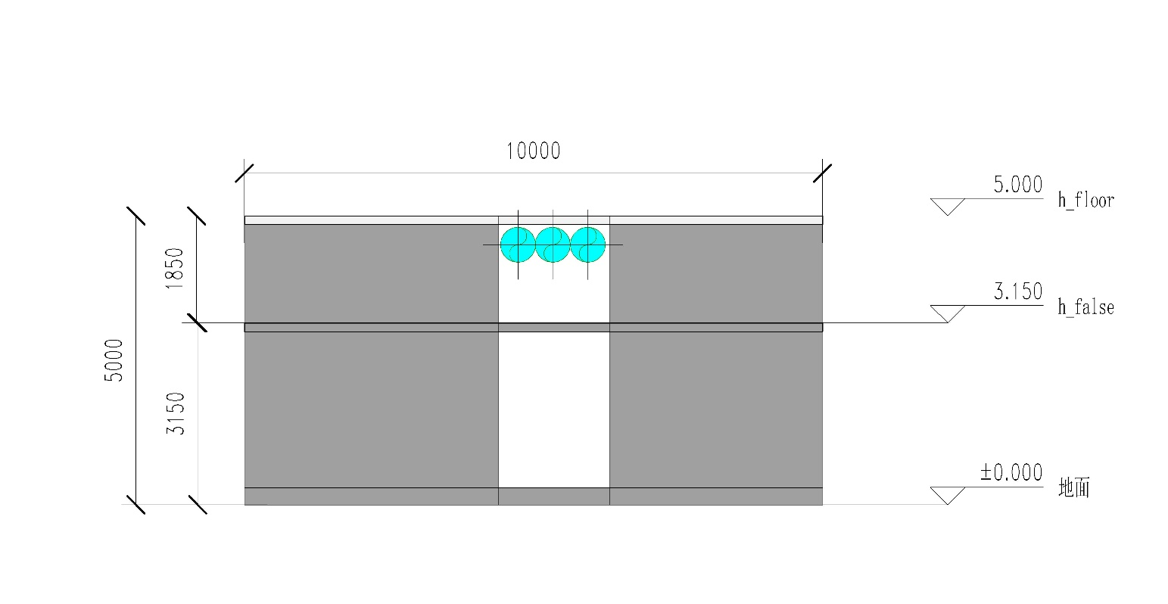
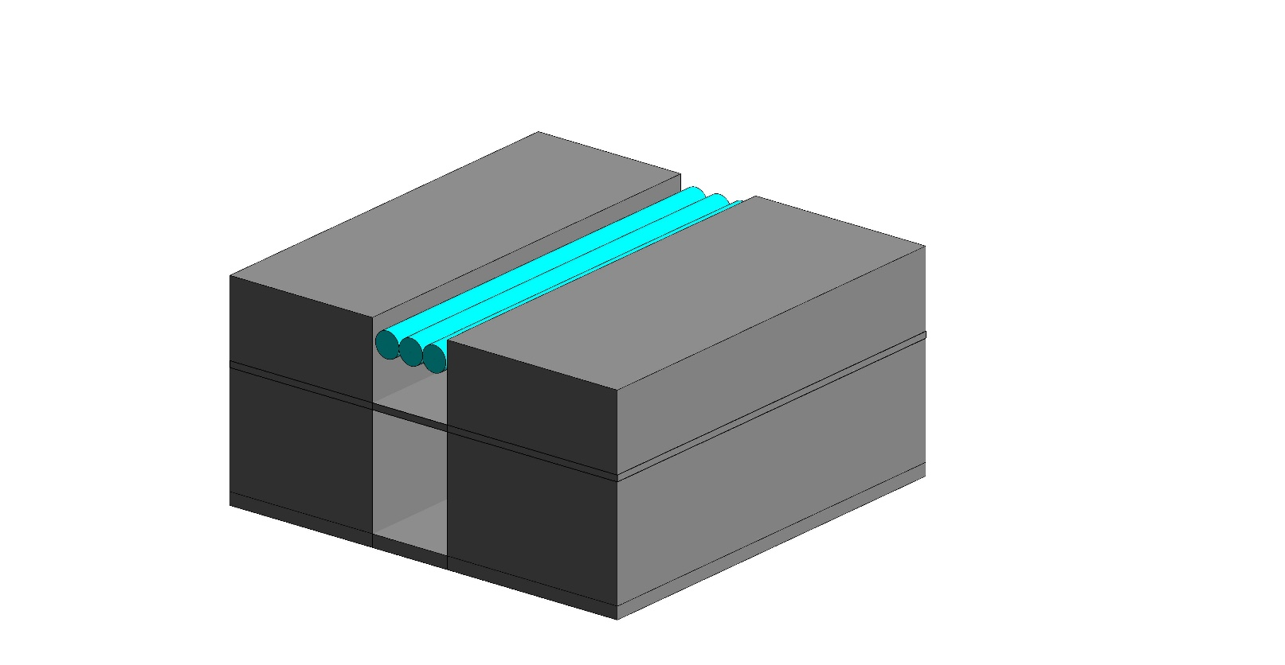
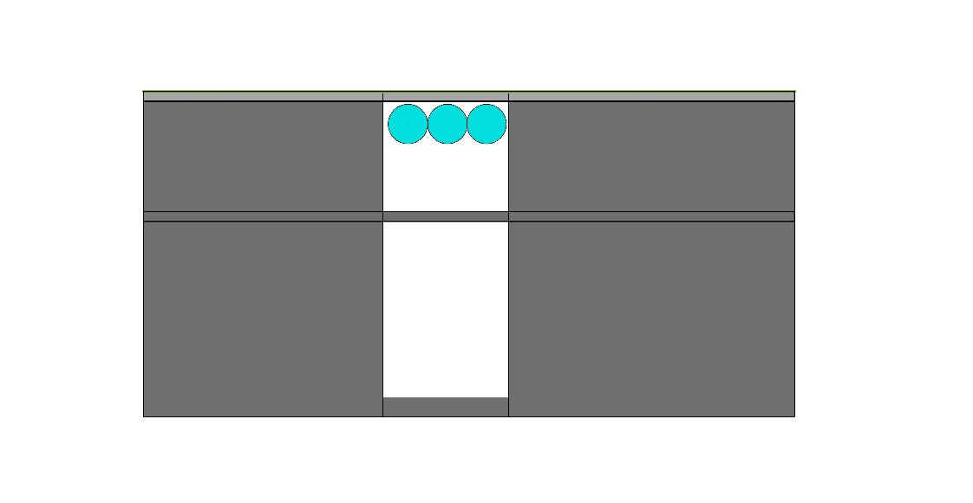
Functional examples: Spacing B
Revit input data
East Section
Φ600mm GraFlow
West Section
Plan
Problem: no space between pipes; when installation space added, one layer is not enough for all pipes

Slide 19
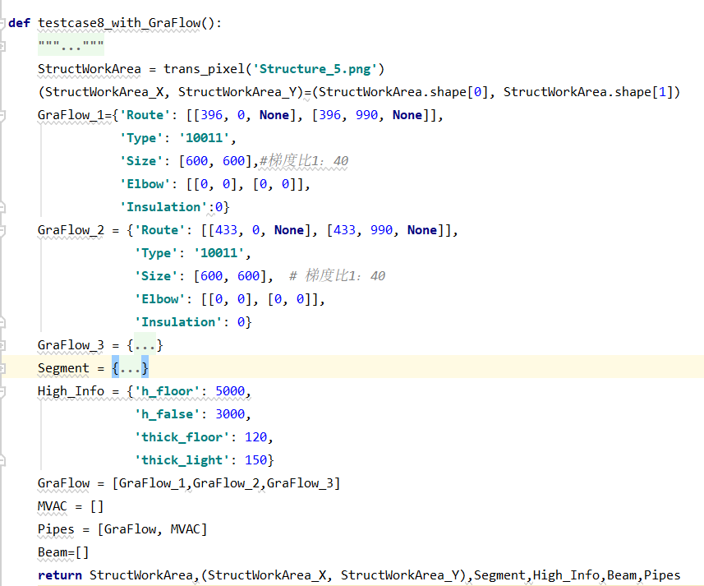
Functional examples: Spacing B
Formatted input

Slide 20
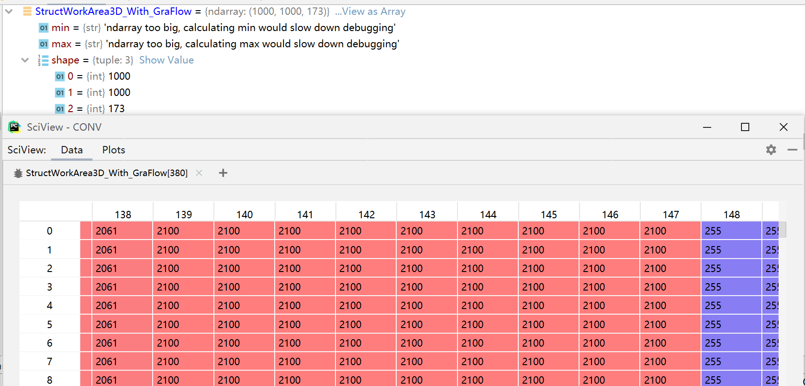
Functional examples: Spacing B
Program output
Visualization step (without Revit): we draw all the pipes in an array, for the figuring
这里放数字那个图

Slide 21
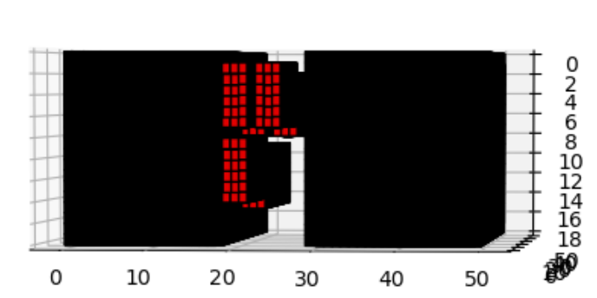
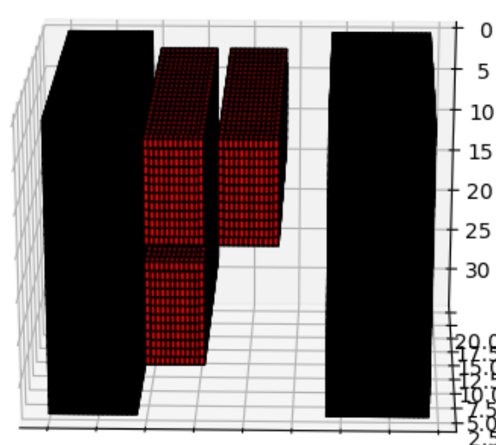
Functional examples: Spacing B
Program output
Can divide them to two layers with correct spacing
Flag1：单层空间不足
第一层的剩余空间不够排布GraFlow_3，排在第二层

Slide 22
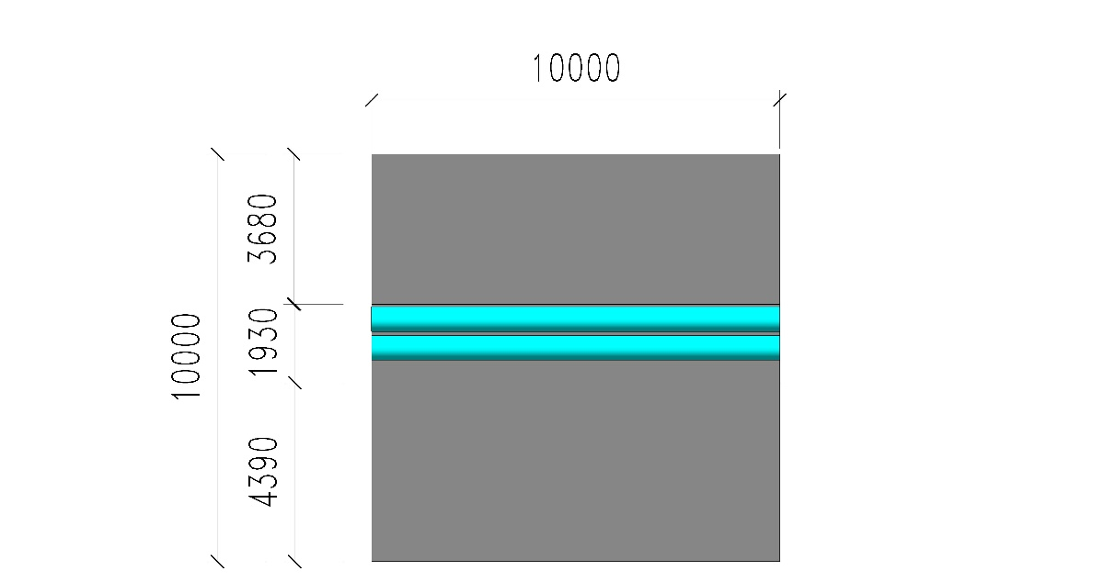
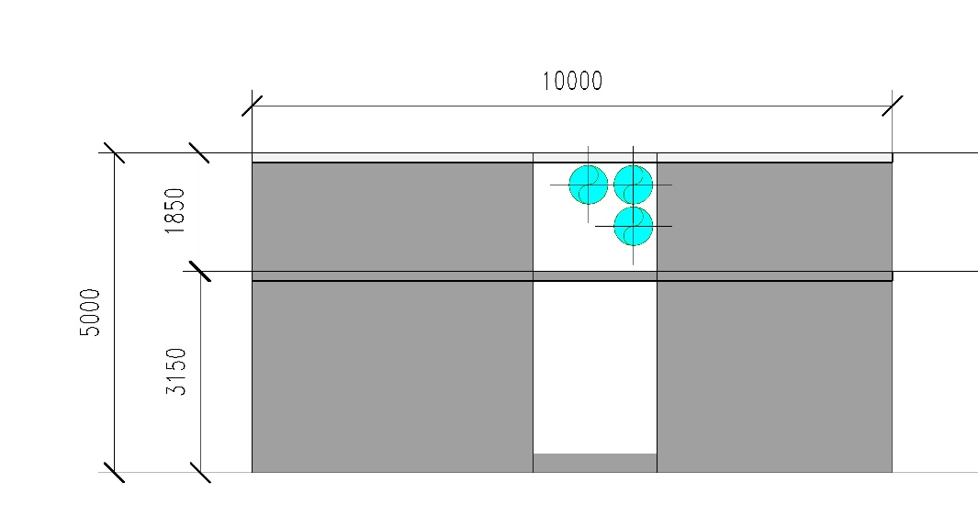
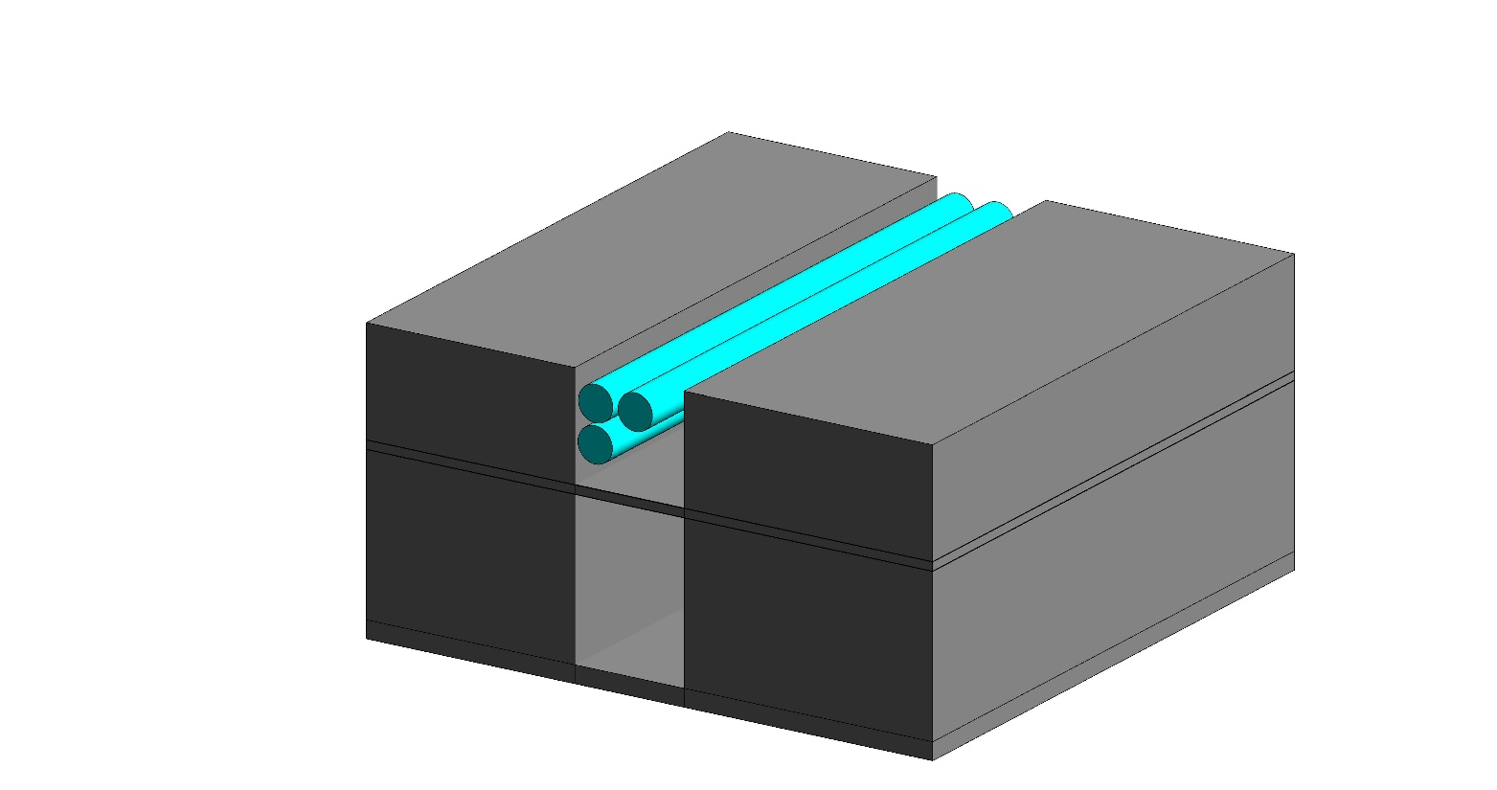
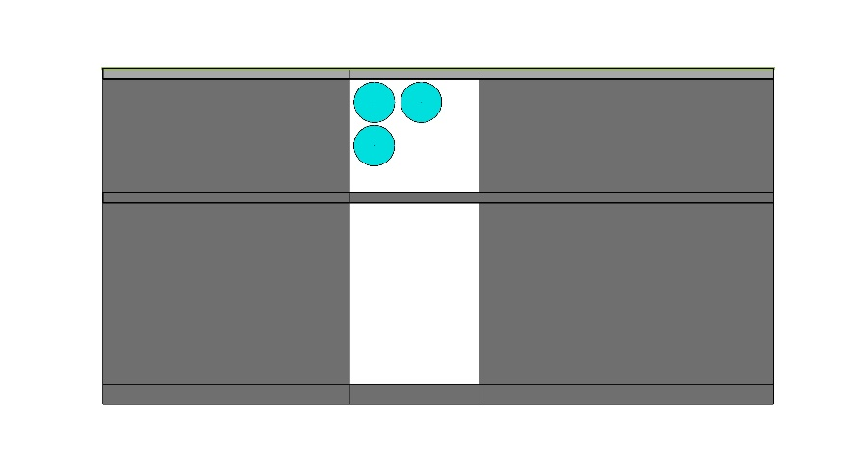
Functional examples: Spacing B
Program output
East Section
Φ600mm GraFlow
West Section
Plan

Slide 23
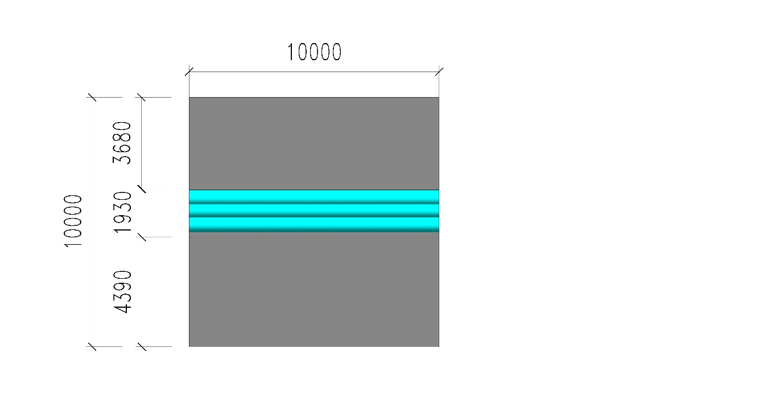
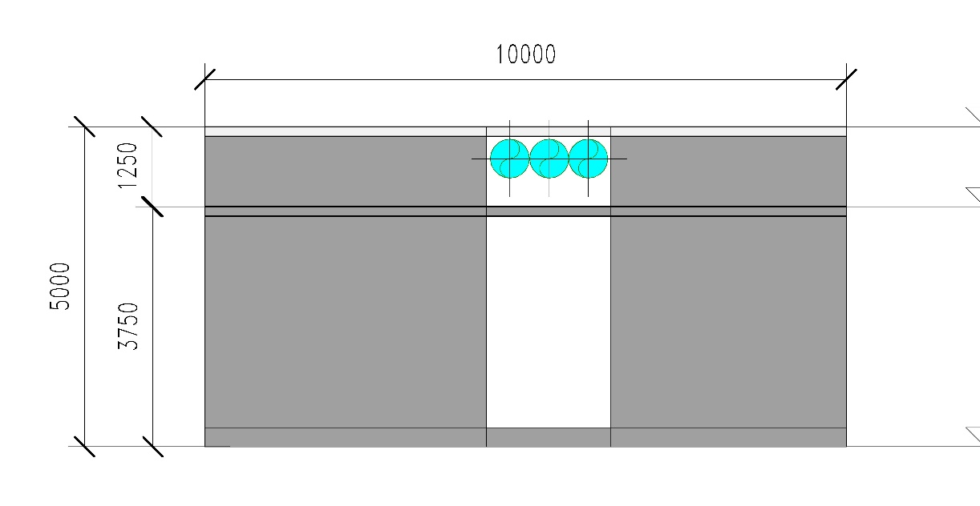
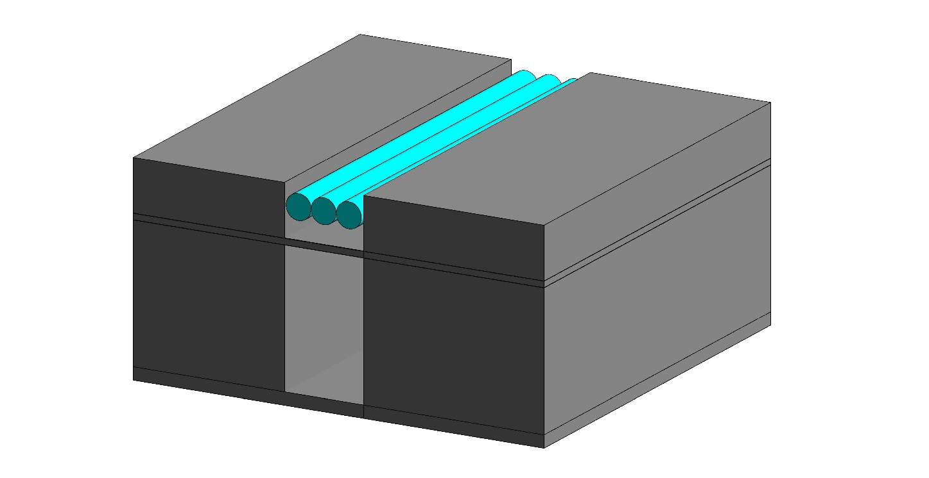
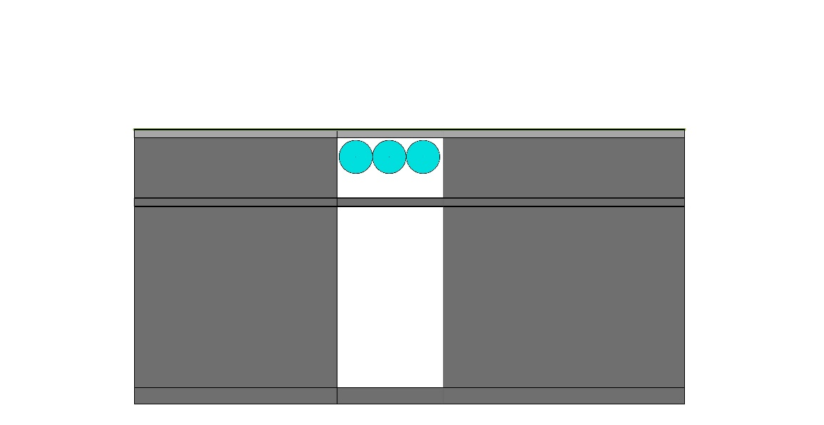
Functional examples: Spacing C
Revit input data
East Section
Φ600mm GraFlow
North Section
Plan
Problem: no space between pipes; when installation space added, not enough space for all pipes;

Slide 24
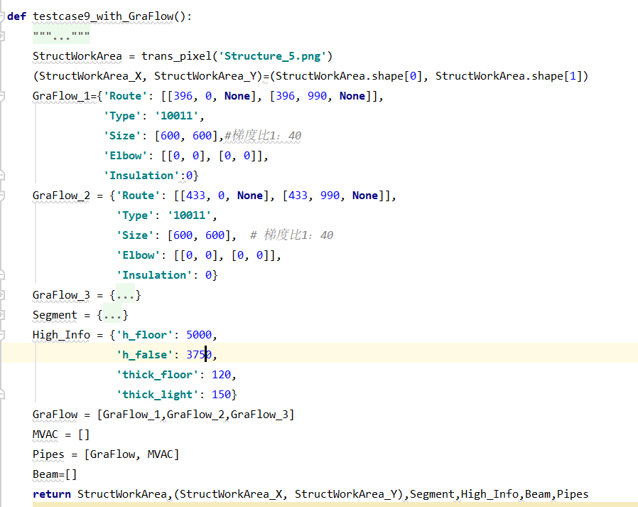
Functional examples: Spacing C
Formatted input

Slide 25
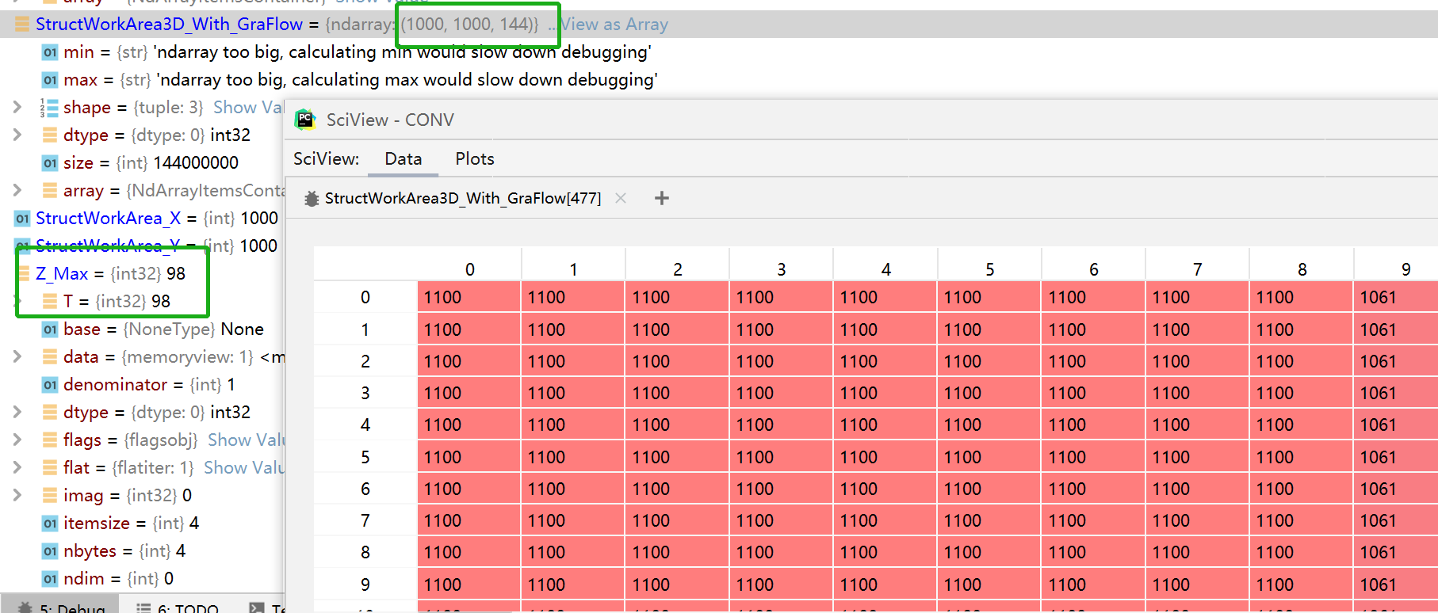
Functional examples: Spacing C
Program output
The difference between 144 and 98 indicates that there is not enough space above the suspended ceiling
这里放数字那个图

Slide 26
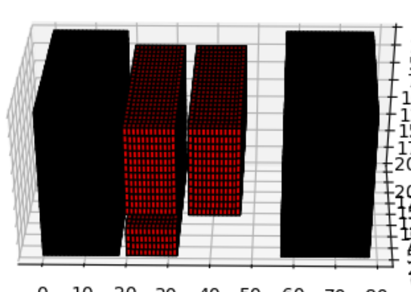
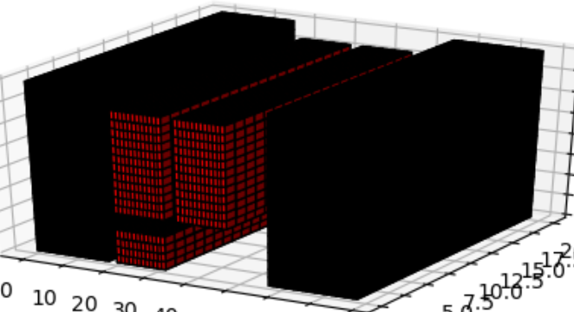
Functional examples: Spacing C
Program output
Flag1：单层空间不足
第一层的剩余空间不够排布GraFlow_3，排在第二层
Flag6：管线排布高度不够，穿过假天花
GraFlow_3穿过假天花，需要增加（144-98）*10mm=460mm高度
We use one block in this figure to represent 10mm, therefore in this case, the ceiling requires 460mm more

Slide 27




Functional examples: Spacing C
Program output
East Section
Φ600mm GraFlow
North Section
Plan

Slide 28




Functional examples: Crossing over A
Revit input data
East Section
Φ400mm GraFlow
Φ300mm GraFlow
North Section
Plan
Problem: blue/yellow pipes go through same space (Gravity Flow)

Slide 29

Functional examples: Crossing over A
Formatted input

Slide 30

Functional examples: Crossing over A
Program output
Visualization step (without Revit): we draw all the pipes in an array, for the figuring
这里放数字那个图

Slide 31

Functional examples: Crossing over A
Program output
In current stage: when Gravity Flow pipe goes down, unless necessary, it will not goes up again
Flag0：两管十字交叉相撞
两管十字交叉，GraFlow_2下折避开GraFlow_1

Slide 32




Functional examples: Crossing over A
Program output
East Section
Φ400mm GraFlow
Φ300mm GraFlow
North Section
Plan

Slide 33




Functional examples: Crossing over A
Revit input data
East Section
1500mmx700mm MVAC
600mmx600mm MVAC
West Section
Plan
Problem: blue/yellow pipes go through same space (MVAC)

Slide 34

Functional examples: Crossing over A
Formatted input

Slide 35

Functional examples: Crossing over B
Program output
Visualization step (without Revit): we draw all the pipes in an array, for the figuring
这里放数字那个图

Slide 36

Functional examples: Crossing over B
Program output
For MVAC: goes down, and then up again
If there is not enough space, it will change the shape of the pipe
When go up, unless necessary, the shape will not be changed back
Flag0：两管十字交叉相撞
两管十字交叉，MVAC_2下折避开MVAC_1再上折
Falg7： MVAC_2空间高度不足
风管改形状，横截面积不变

Slide 37




Functional examples: Crossing over B
Program output
East Section
1500mmx700mm MVAC
600mmx600mm MVAC
North Section
Plan

Slide 38




Functional examples: Crossing over C
Revit input data
East Section
Φ700mm GraFlow
600mmx600mm MVAC
North Section
Plan
Problem: blue/yellow pipes go through same space (mixed Gravity Flow & MVAC)

Slide 39

Functional examples: Crossing over C
Formatted input

Slide 40

Functional examples: Crossing over C
Program output
Visualization step (without Revit): we draw all the pipes in an array, for the figuring
这里放数字那个图

Slide 41

Functional examples: Crossing over C
Program output
Flag7：MVAC_1空间高度不足
风管改变形状，横截面积不变
Flag9：水管与风管十字交叉相撞
两管十字交叉，MVAC_2下折避开GraFlow_1再上折

Slide 42




Functional examples: Crossing over C
Program output
East Section
Φ700mm GraFlow
600mmx600mm MVAC
这里放Revit结果图
North Section
Plan

Slide 43




Functional examples: 30m’s law
Revit input data
Problem: Gravity Flow longer than 30m
Φ250mm GraFlow
East Section
Problem: Gravity Flow longer than 30m
West Section
Plan

Slide 44

Functional examples: 30m’s law
Formatted input

Slide 45

Functional examples: 30m’s law
Program output
Visualization step (without Revit): we draw all the pipes in an array, for the figuring

Slide 46


Functional examples: 30m’s law
Program output
Program output
Flag8：水管长度超过30m
GraFlow_1在从起点开始，长度30m处下降200mm
We use one block in this figure to represent 10mm, therefore in this case, the drop is (69-49) *10mm = 200mm

Slide 47





Functional examples: 30m’s law
Program output
Φ250mm GraFlow
East Section
West Section
Plan

Slide 48




Functional examples: Go through the Beam A
Revit input data
East Section
Φ60mm GraFlow
West Section
Plan
Problem: a lot of small pipes, they are required to be as high as possible (close to the ceiling), therefore should go through the beam

Slide 49

Functional examples: Go through the Beam A
Formatted input

Slide 50

Functional examples: Go through the Beam A
Program output
Visualization step (without Revit): we draw all the pipes in an array, for the figuring
这里放数字那个图

Slide 51


Functional examples: Go through the Beam A
Program output
In current stage: the pipes will go through the beam, if they can, within 1/3 – 2/3 space.
1/3
2/3
Not larger than 250mm
Flag3：水管直径小于250mm穿梁
10条水管直径都小于250mm，并且全部排列后总高度不超过250mm，全部进行穿梁处理
Flag1：单层空间不足
横梁中剩余空间不足，GraFlow_9和GraFlow_10排在横梁的第二层

Slide 52




Functional examples: Go through the Beam A
Program output
East Section
Φ60mm GraFlow
West Section
Plan

Slide 53




Functional examples: Go through the Beam B
Revit input data
Φ300mm GraFlow
10000
East Section
Φ100mm GraFlow
3070
10000
3500
West Section
3430
Plan
Problem: pipes with Dia. <= 250mm can go through the beam, and those with Dia. > 250mm cannot

Slide 54

Functional examples: Go through the Beam B
Formatted input

Slide 55

Functional examples: Go through the Beam B
Program output
Visualization step (without Revit): we draw all the pipes in an array, for the figuring
这里放数字那个图

Slide 56

Functional examples: Go through the Beam B
Program output
Flag3：水管直径小于250mm穿梁
GraFlow_1直径不足250mm，进行穿梁处理
Flag0：管线与梁冲突
GraFlow_2下折绕梁

Slide 57




Functional examples: Go through the Beam B
Program output
East Section
Φ300mm GraFlow
Φ100mm GraFlow
West Section
Plan

Slide 58




Functional examples: Automatic aligning
Revit input data
East Section
Φ300mm GraFlow
300mmx3000mm MVAC
West Section
Plan
Problem: different types of pipes occupy same space

Slide 59

Functional examples: Automatic aligning
Formatted input

Slide 60

Functional examples: Automatic aligning
Program output
Visualization step (without Revit): we draw all the pipes in an array, for the figuring

Slide 61



Functional examples: Automatic aligning
Program output
Gravity Flow and MVAC in two sides of the corridor
the pipes turn right/left along with the wall
Flag1：单层空间不足
GraFlow_3和MVAC_3排在第二层

Slide 62




Functional examples: Automatic aligning
Program output
East Section
Φ300mm GraFlow
300mmx3000mm MVAC
West Section
Plan

Slide 63


Algorithm output: case example
Revit input data
1000mmx400mm MVAC
2000mmx400mm MVAC
Φ250mm GraFlow
Φ250mm GraFlow
East Section
Plan
Now we go back to this case and see how to tackle these problems:
different types of pipes occupy same space
Some law might be violated (e.g. 30m’ law)
Might not be enough space (height)
West Section

Slide 64

Algorithm output: case example
Formatted input

Slide 65

Algorithm output: case example
Program output
Visualization step (without Revit): we draw all the pipes in an array, for the figuring
这里放数字那个图

Slide 66


Algorithm output: case example
Program output
beam

Slide 67

Algorithm output: case example
Program output
Flag3：水管直径小于250mm穿梁
GraFlow_1直径不足250mm，进行穿梁处理
Shows the Gravity Flow only
It goes through the beams, and continuously going dowm

Slide 68

Algorithm output: case example
Program output
Shows the MVAC only
It is larger than 250mm, thus run under the beams
Installation space is given between pipe and beams

Slide 69

Algorithm output: case example
Program output
Flag0：两管十字交叉相撞，小管下折避开大管
MVAC_1下折避让MVAC_5
Flag6：管线排布高度不够，穿过假天花
MVAC_1下折穿过假天花

Slide 70


Algorithm output: case example
Program output
For this pipe, there is no beam between the beginning point and end point, therefore, to save room, make it as high as possible

Slide 71


Algorithm output: case example
Program output
Flag8：水管长度超过30m
GraFlow_2在从起点开始，长度30m处下降200mm

Slide 72


Algorithm output: case example
Program output
Flag3：水管直径小于250mm穿梁
GraFlow_2直径不足250mm，进行穿梁处理
Flag6：管线排布高度不够，穿过假天花
GraFlow_2穿过假天花，需要增加（123-101）*10mm=220mm高度
30m’s law make the pipe goes down for 200mm, making such problem happened in a more severe way

Slide 73
Algorithm output: case example
Program output
1000mmx400mm MVAC
2000mmx400mm MVAC
Φ250mm GraFlow
East Section
West Section
Plan

Slide 74




Algorithm output: case example
Program output

